Slide 1
NAME : SREEHARI KARICHERY , 166589 DEVOPS TRAINING TRAINER : VENKAT DAY 2 , FEB 10
LINUX COMMANDS

Slide 2
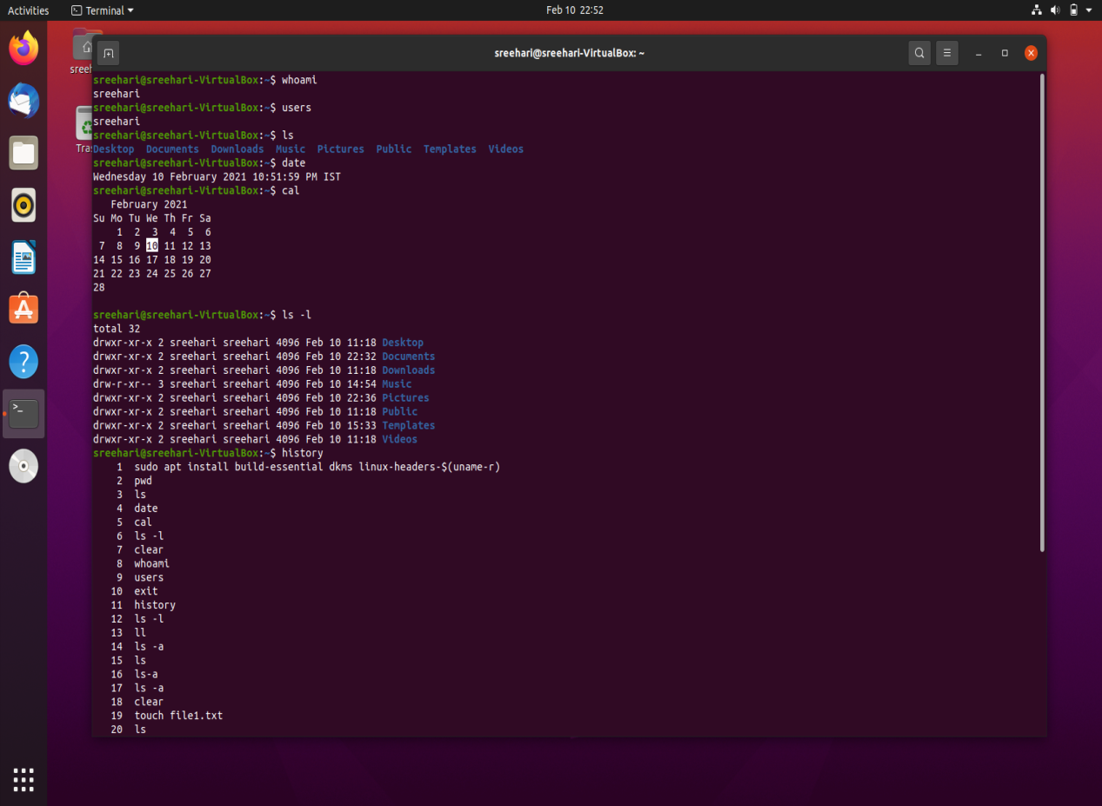
COMMANDS
whoami - Displays the user name
ls - listing files or directories in linux
date - display the date and time
cal - displays the system calender
users -displays the registered users
la -l - list all the files and directories
in long format
history - shows the history of all
commands used

Slide 3
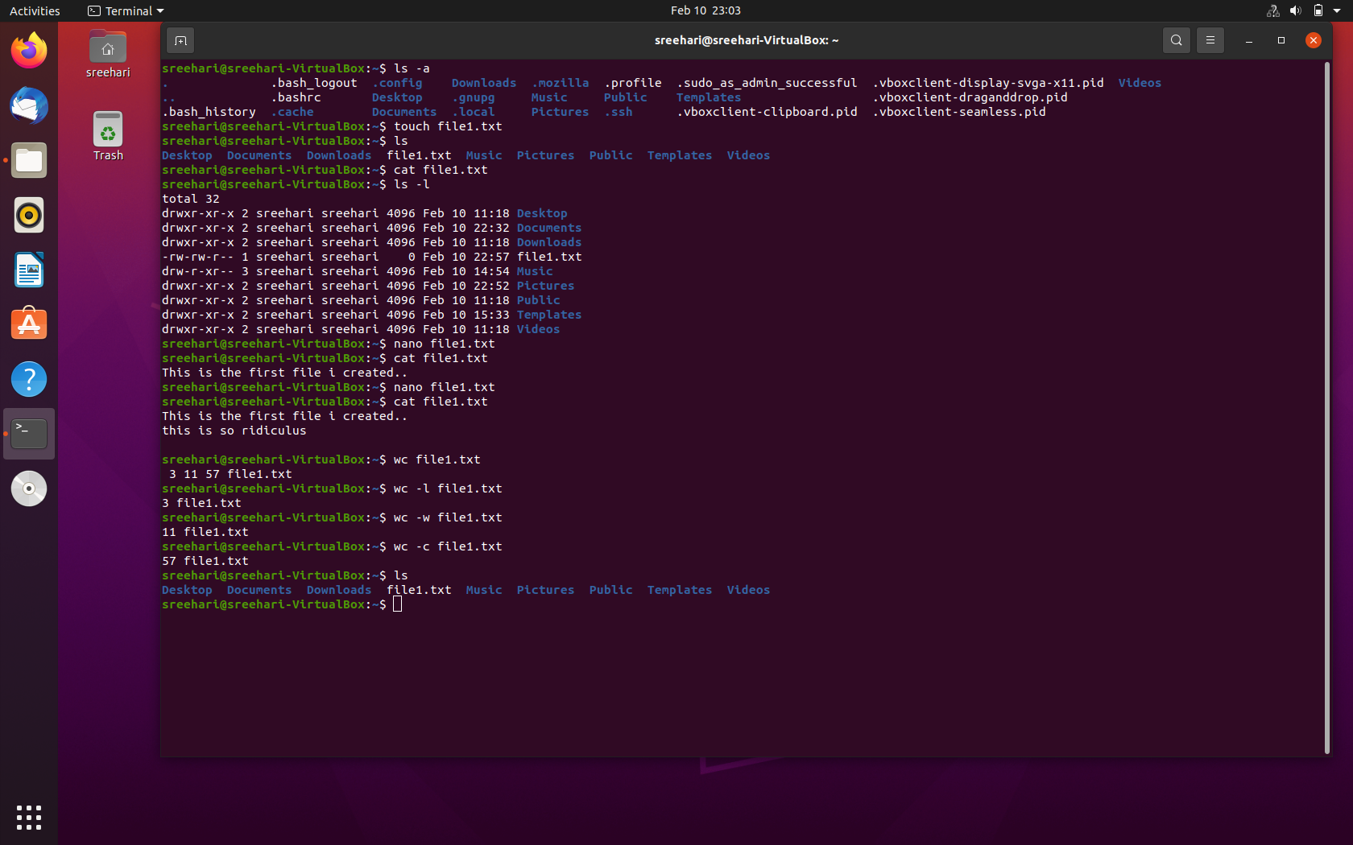
COMMANDS
la –l -displays all the files including
the hidden files
touch file - to create a new text file
nano file - to add contents in the
file
cat file - gives the contents of the
file
wc file - count lines of words ,bytes
and characters
wc -l file - length of longest line
wc -w file - words in a file
wc -c file - count of bytes

Slide 4
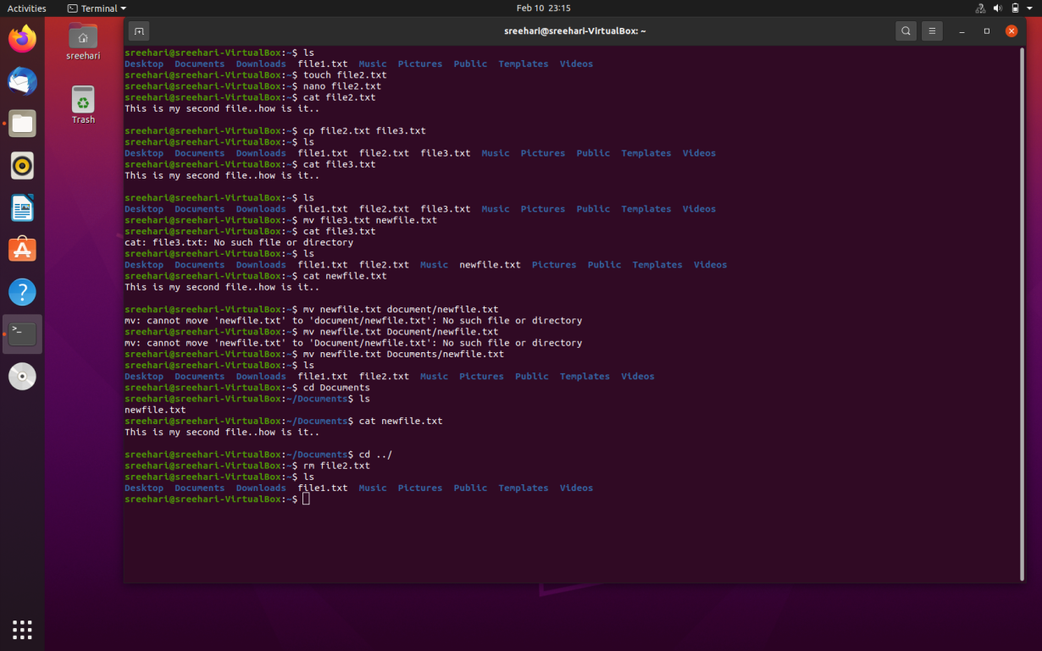
COMMANDS
cp file2 file3 - copy contents of file2
to file3
mv file3 newfile - to move complete
data from file3 to
newfile
mv newfile Documents/newfile - moves
the file newfile into
the folder Documents
cd - change directory
rm file - removes a text file

Slide 5
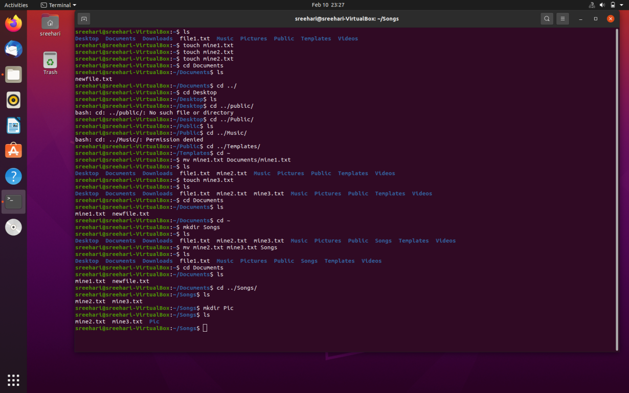
COMMANDS
mkdir name - make a new directory
cd ../ - go back to previous directory
cd ~ - back to the main home
cd ../Songs/ - jumping btwn directories

Slide 6
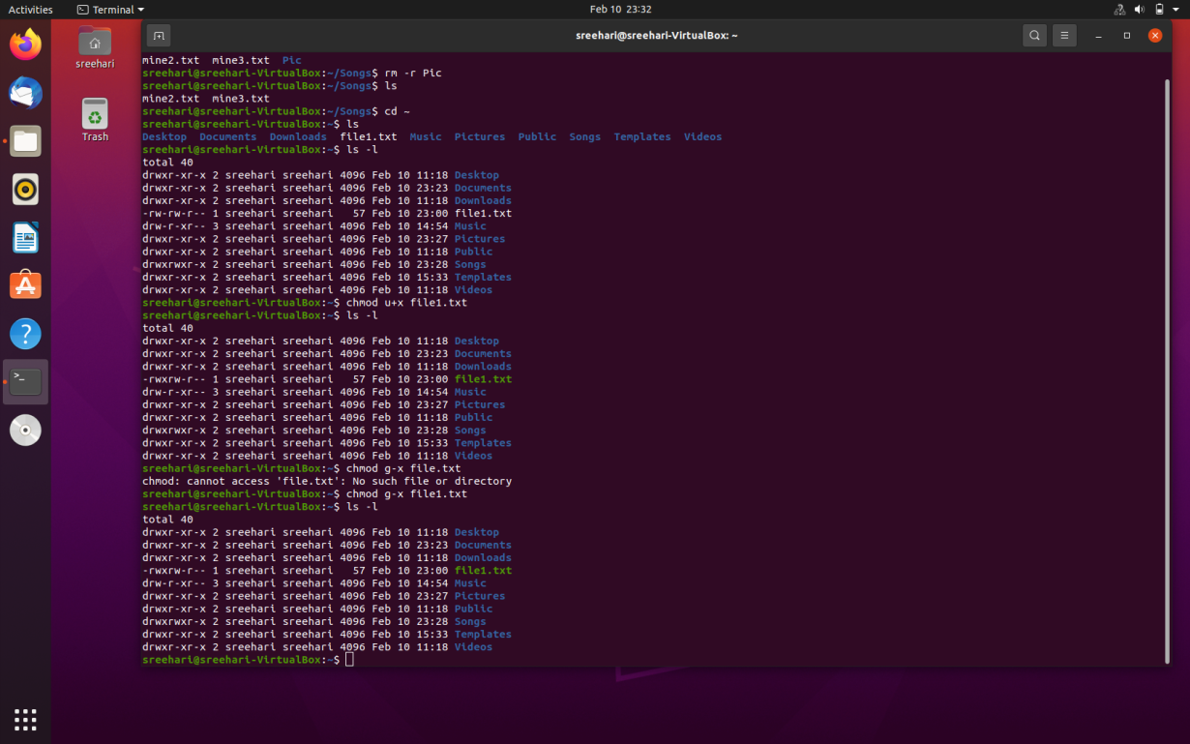
COMMANDS
rm file -removes file
rm -r name - removes a directory
cd ../../ - navigate through parent
child files

Slide 7
COMMANDS
ADDING OR TAKING PERMISSIONS
chmod u+x file - Add execution
permission for users
chmod g-w file -remove write permission
for groups
chmod o+x file- add execution permission
for others
o - others
g - groups
a - all

Slide 8
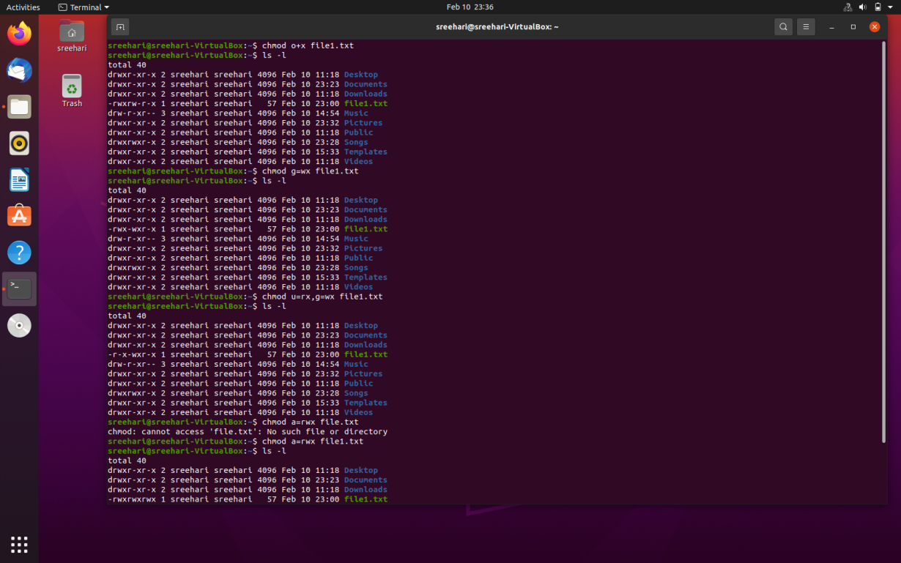
COMMANDS
chmod g=wx file - add permission to
group to write and
execute
chmod u=rx file - users ve the permission
to read and execute
chmod a=rwx - add permission to all to
read,write and execute

Slide 9
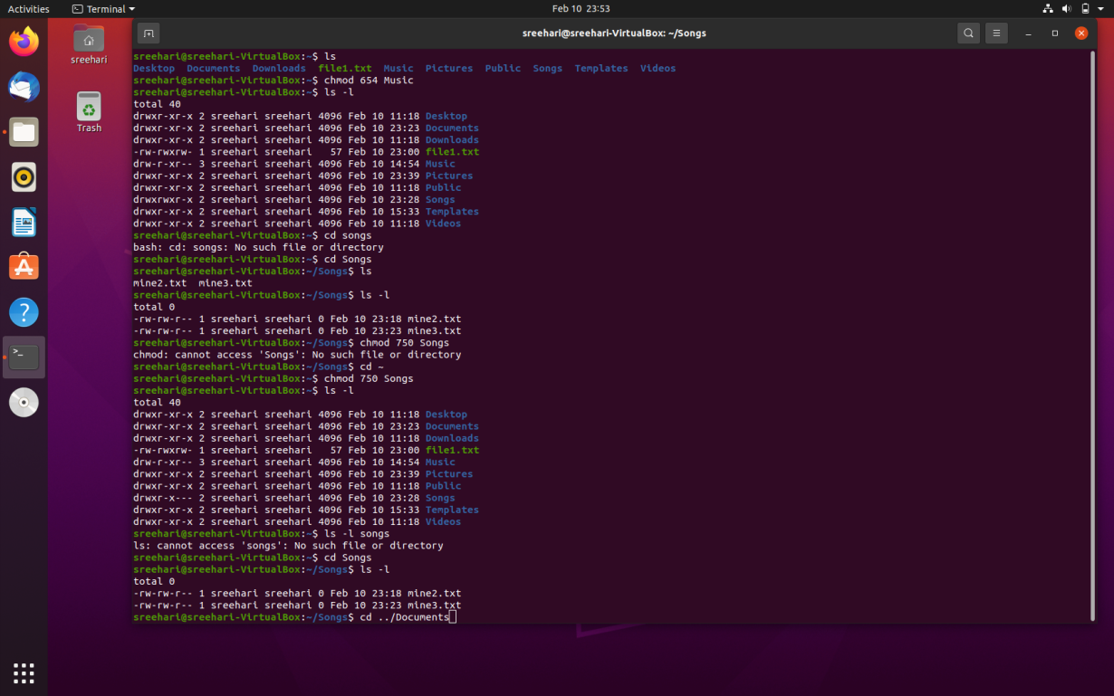
COMMANDS
SET USING OCTAL SYSTEM
NUMBER PERMISSION
0 - no permission
- execute
-write
-execute & write
- read
-read & execute
-read & write
- all permissions
chmod 750 filename - drwxr-x----

Slide 10
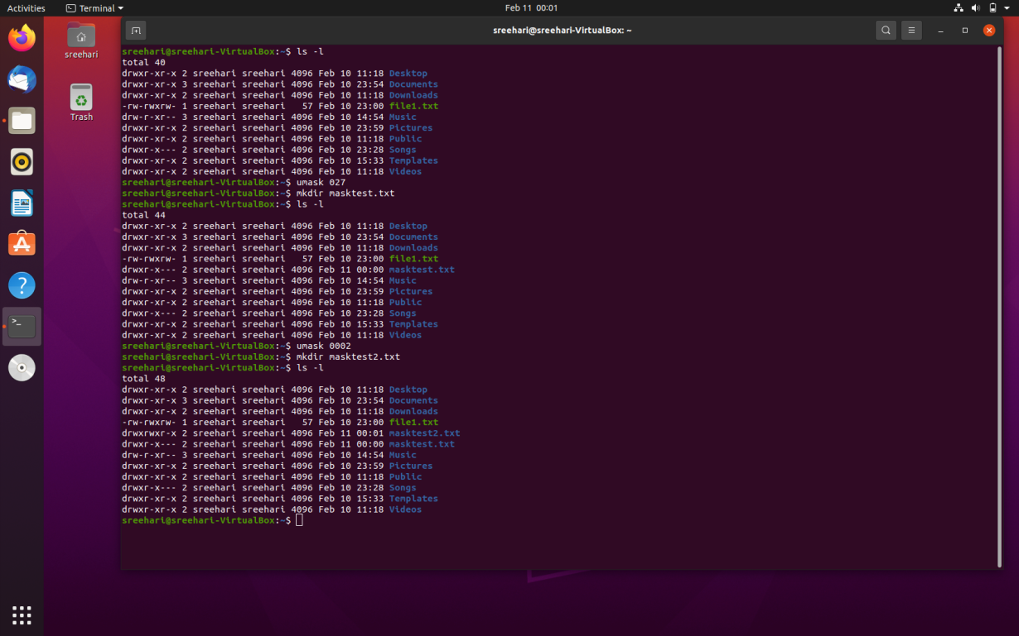
COMMANDS
umask octal - set default permission
default umask value is 0002

Slide 11
THANK YOU

